Slide 1
Transform Pandas DataFrame

Slide 2

Agenda
Introduction
Pivot Table
Pandas Styling
Conclusion

Slide 3

Pandas Style is a module in the Pandas library that offers tools for producing HTML-styled versions of DataFrames. This feature permits users to personalize the visual display of DataFrames when viewing them. The primary function of Pandas Style is its capacity to emphasize, color, and format cells based on specific criteria, aiding in the visual detection of patterns and trends within datasets.
Introduction

Slide 4
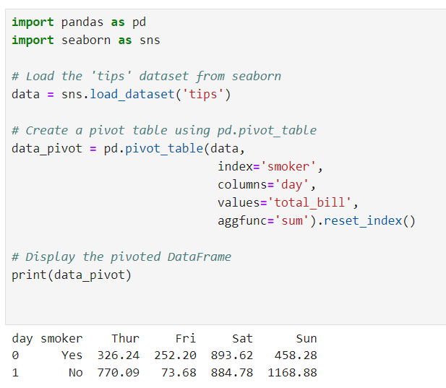
Pivot Table
pivot tables are a structured way of presenting summarized data from a table, arranging information based on one variable, and showing values related to another variable.

Slide 5
Pandas Styling
The style module offers a variety of choices for altering the appearance of the data, giving us the ability to personalize aspects such as:
Cell Coloring: Applying various colors depending on cell values or conditions.
Highlighting: Drawing attention to specific rows, columns, or values.
Formatting: Modifying the format of the displayed values, including precision and alignment.
Bar Charts: Displaying data using horizontal or vertical bar charts within

Slide 6
Conclusion
The Styler object is a property that provides valuable methods for formatting and presenting DataFrames. Styling is achieved through the use of CSS. By creating "style functions" that accept scalars, DataFrames, or Series, you can generate DataFrames or Series with CSS "attribute: value" pairs corresponding to the values.

Slide 7
Conclusion
If the goal is to maximize revenue, then the objective function could be the overall revenue generated from selling tickets to the customers.
Constraints : These are the limitations for real- world price optimization and the requirements that should be considered when to determine the price
Optimization. These constraints includes: maximum & minimum prices of tickets, available inventory, number of seats left, Days left before travel, or any other business constraints related to business.

Slide 8


Thank You
dSights is a data tech specialist with a vision to create value through:
Outcome-Oriented AI
Fueled by
Innovative Experimentation

